Slide 1
FluId Power Systems
BY Dr. OMARI MASHI KHALFAN
nit, MECHANICAL ENGINEERING DEPT.

Slide 2
HYDRAULIC ACCUMULATOR
A hydraulic accumulator is a device used in hydraulic systems to store energy. The storage is achieved by the ability of the device in keeping hydraulic fluid at high pressures as a result of compressibility of the gas the accumulator contains.
Construction and Operation:
Basically, accumulator is a cylinder which contains two types of fluids (gas and oil) separated by a bladder, diaphragm or piston depending on the type of accumulator.
The gas portion of the device is initially filled with a gas (generally nitrogen) at a certain charge pressure, P0 then oil is filled into the liquid portion up to a maximum operating pressure required P2. Then oil is discharged as pressurized gas expands until minimum operating pressure is reached P1.

Slide 3
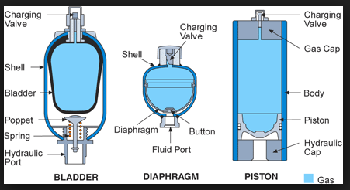
TYPES OF ACCUMULATORS

Slide 4
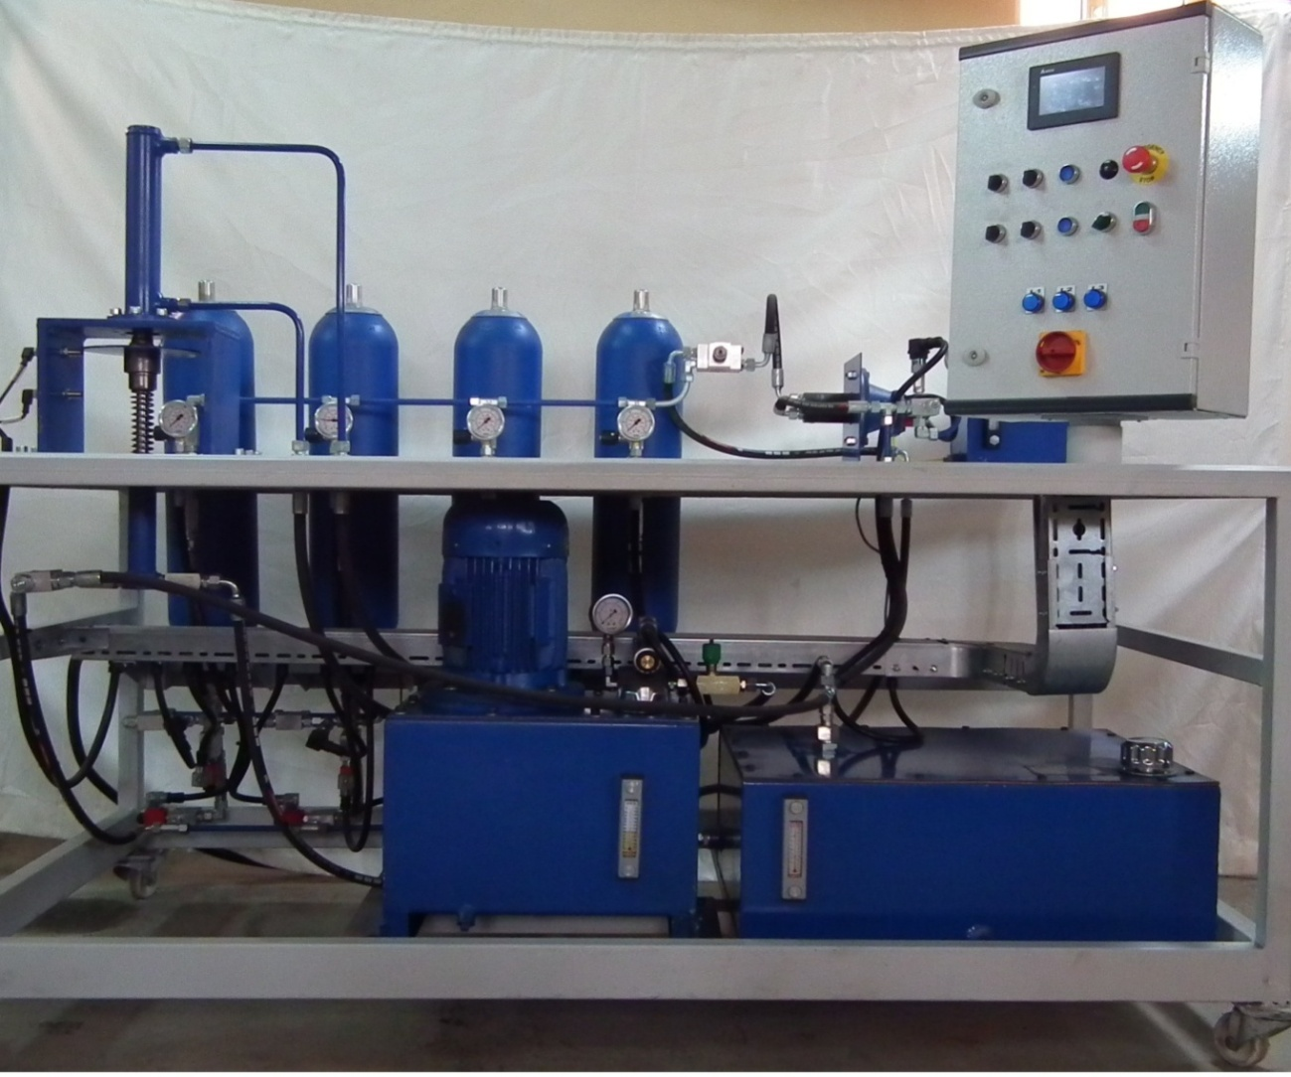
ACCUMULTORS

Slide 5
FUNCTIONS OF ACCUMULATORS
Accumulators have several functions in a hydraulic system. These are:
Energy storage . Fluid at high pressure can be stored in accumulator.
Used as a back up system in case of power failure (when no electricity the system can operate in emergency)
Provide additional volume of hydraulic oil into the system
Deadening pressure pulsation in hydraulic systems
Maintaining constant fluid flow when system demand is greater than pump supply

Slide 6
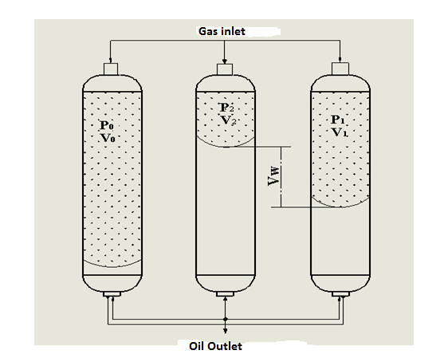
ACC-PRESSURE AND VOLUME RELATIONSHIP

Slide 7
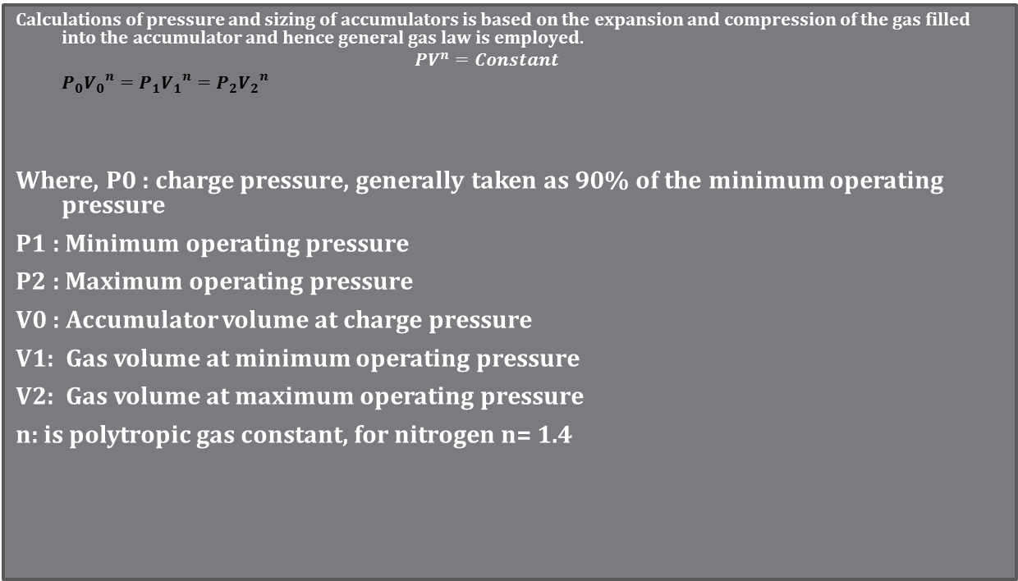
GENERAL GAS LAW
Calculations of pressure and sizing of accumulators is based on the expansion and compression of the gas filled into the accumulator and hence general gas law is employed.
$$PV^{n}=Constant$$
$$P_{0}{V_{0}}^{n}=P_{1}{V_{1}}^{n}=P_{2}{V_{2}}^{n}$$
Where, P0 : charge pressure, generally taken as 90% of the minimum operating pressure
P1 : Minimum operating pressure
P2 : Maximum operating pressure
V0 : Accumulator volume at charge pressure
V1: Gas volume at minimum operating pressure
V2: Gas volume at maximum operating pressure
n: is polytropic gas constant, for nitrogen n= 1.4

Slide 8
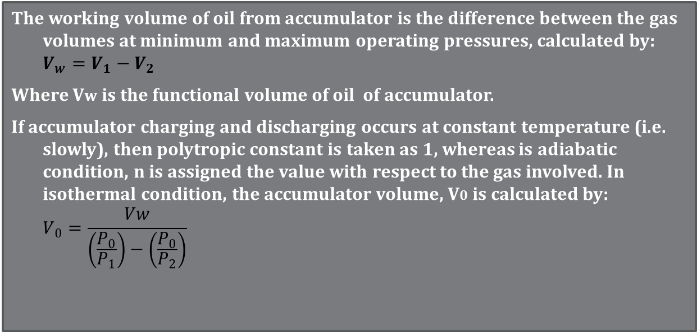
GENERAL GAS LAW
The working volume of oil from accumulator is the difference between the gas volumes at minimum and maximum operating pressures, calculated by:
$$V_{w}=V_{1}−V_{2}$$
Where Vw is the functional volume of oil of accumulator.
If accumulator charging and discharging occurs at constant temperature (i.e. slowly), then polytropic constant is taken as 1, whereas is adiabatic condition, n is assigned the value with respect to the gas involved. In isothermal condition, the accumulator volume, V0 is calculated by:
$$V_{0}=\frac{Vw}{\left(\frac{P_{0}}{P_{1}}\right)−\left(\frac{P_{0}}{P_{2}}\right)}$$

Slide 9
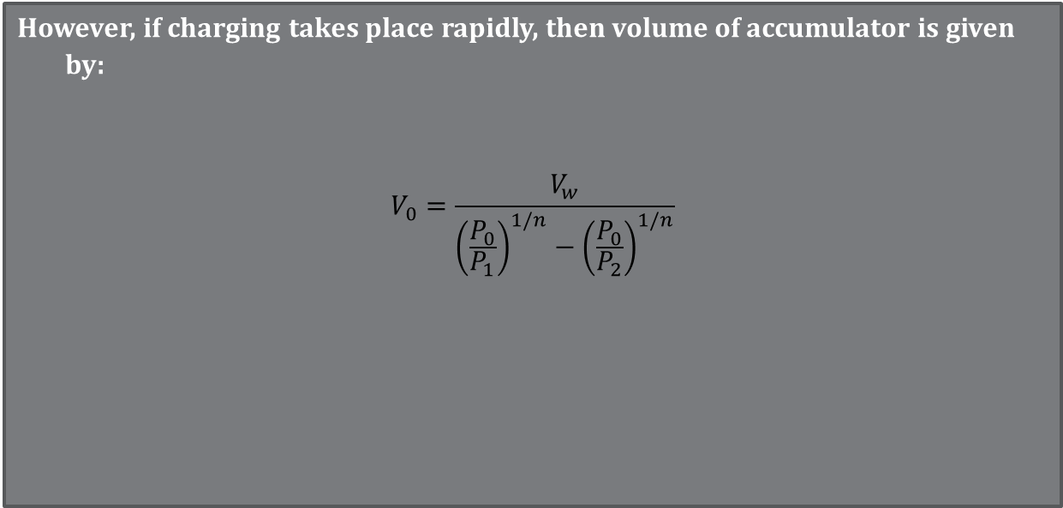
GENERAL GAS LAW
However, if charging takes place rapidly, then volume of accumulator is given by:
$$V_{0}=\frac{V_{w}}{{\left(\frac{P_{0}}{P_{1}}\right)}^{1/n}−{\left(\frac{P_{0}}{P_{2}}\right)}^{1/n}}$$

Slide 10
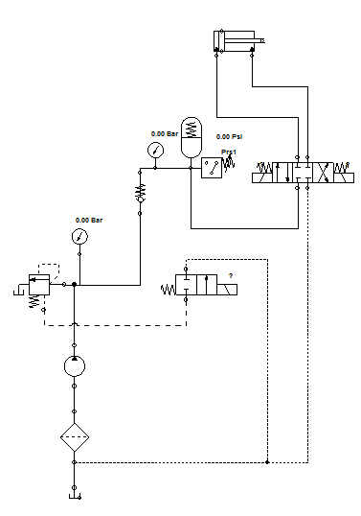
ACCUMULATOR CIRCUIT

Slide 11
example
An accumulator is to deliver 4 L of oil when ,operating between 207 bar and 110 bar in 0.8 s.
It is assumed here that the operating pressure is achieved by a slow charging process
such that the ideal isothermal process n = 1 may be assumed. If the gas used in the bladder has n=1.82. What is the size of the accumulator?
Solution:
Given :P2= 207 bar, P1=110 bar, n= 1.82 therefore pre-charge pressure, P0= 90% P1 = 110(0.9)=99 bar.

Slide 12
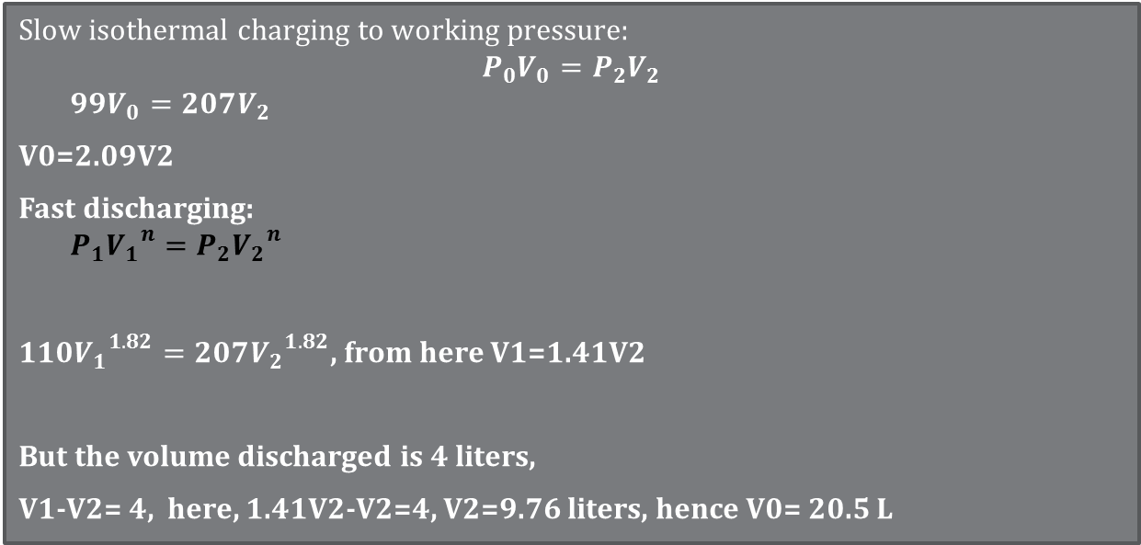
solution
Slow isothermal charging to working pressure:
$$P_{0}V_{0}=P_{2}V_{2}$$
$$99V_{0}=207V_{2}$$
V0=2.09V2
Fast discharging:
$$P_{1}{V_{1}}^{n}=P_{2}{V_{2}}^{n}$$
$110{V_{1}}^{1.82}=207{V_{2}}^{1.82}$, from here V1=1.41V2
But the volume discharged is 4 liters,
V1-V2= 4, here, 1.41V2-V2=4, V2=9.76 liters, hence V0= 20.5 L

Slide 13
PRESSURE CONTROL VALVES
1. Counterbalance Valve
Counterbalance valves are among pressure controlling valves used to control overrunning loads from falling uncontrollably.
Overrunning loads are loads that act in the same direction as actuator motion.
On the contrary; the loads that act in opposite direction to the actuator motion are known as Resistive loads.
Essentially; a counterbalance valve is a pressure relief valve incorporated with a check valve and a pilot line.
The valve allows free flow to the actuator in one direction and blocks the flow in opposite direction until a set threshold pressure value is reached.
A counterbalance valve with an additional externally piloted line is commonly known as a brake valve. This is commonly used in controlling hydraulic motors from running out of control.

Slide 14
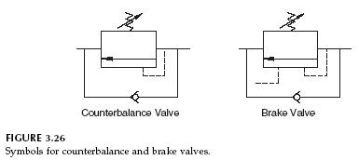
Counterbalance and brake valve symbols

Slide 15
Functions of a counterbalance valve
Counterbalance valves have the following functions;
Allowing free flow for resistive loads
Blocking reverse flow when the directional valve is not operated.
Allowing controllable lowering of an overrunning load by metering the flow when the directional valve is operated.
Provides pressure relief within the actuator against pressure surges.
Helps in preventing cavitation in a pump by restricting oil to be sucked faster than the pump can allow.
The most common applications of a counterbalance valve are the hydraulic presses with large platens and hydraulic motors with winch drives.

Slide 16
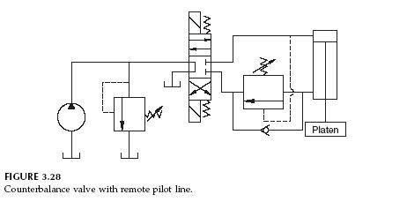
Counterbalance valve circuit
In hydraulic circuits; a counterbalance is generally located between a directional control valve and the exit port of a vertical cylinder which supports an overrunning load.

Slide 17
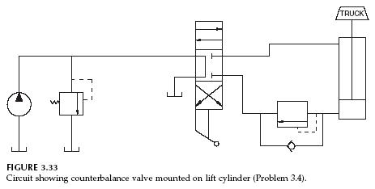
Counterbalance valve circuit

Slide 18
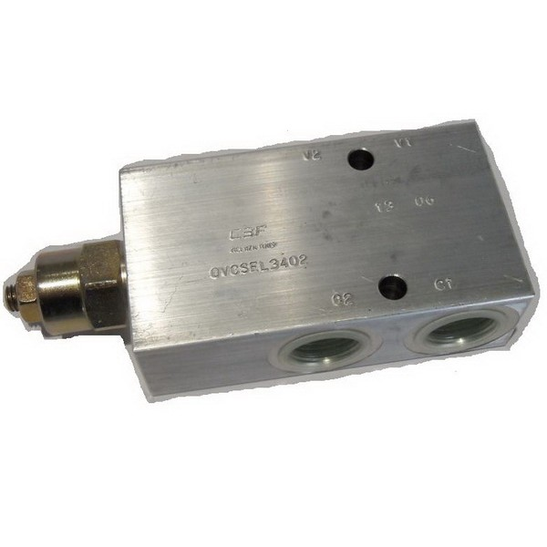
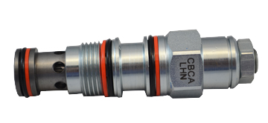
Plate and cartridge types counterbalance valves

Slide 19
2. Sequence valve
A sequence valve is among the pressure control valves that are used to prevent an actuator from operating until a certain pressure is reached. This is commonly set in order to a achieve a sequence of operations where one operation must be performed before another starts.
A sequence valve resembles a pressure reducing valve in that they both have an external drain to the reservoir. However; a sequence valve is a normally closed valve while the pressure reducing valve is a normally open valve.

Slide 20
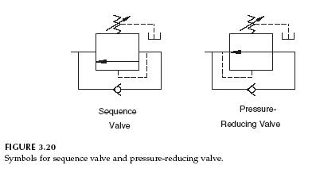
Sequence and pressure reducing valve symbols

Slide 21
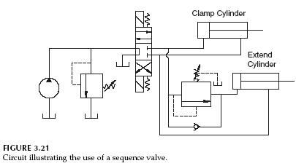
Sequence valve circuit

Slide 22
Sequence valve applications
A sequence valve is sought for when a clamping and drilling actions are to be executed.
The clamping cylinder has to start moving and accomplishes its action before the drilling action starts; therefore a sequence valve is incorporated to the inlet of the second cylinder (drilling) hence prevents it from moving until the predetermined pressure value is reached. (i.e. after completing clamping action)

Slide 23
3. Unloadıng valve
This type of hydraulic valve is used to unload pump (i.e. directing pump flow to tank at a low pressure) when a required pressure in the system is reached. An unloading valve principally operates as a pressure relief valve but at a relatively lower pressure. This circuit is used:
when an accumulator is used with a closed centre valve, or
when two pumps (high-low) are used together and one is to be unloaded after a certain pressure value .

Slide 24
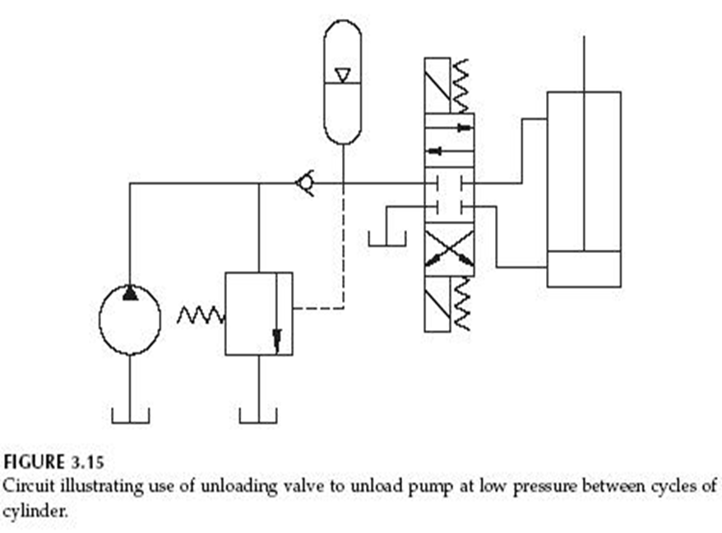
i.UnloadIng circuit with Accumulator
Accumulator
Unloading Valve

Slide 25
ii. Unloading Valve with Hi-lo Pumps
Pressure Relief Valve
Unloading Valve

Slide 26
4. Double pilot operated check valve
In most heavy duty hydraulic presses, the press table connecting the cylinder needs to be locked in place when the press is off duty. This is achieved by incorporating a double check pilot operated valve in the system. In this way, the table (cylinder) remains in its required position and no external load (such as the table’s weight) can move it.
Double check pilot operated valve differs from a normal check valve in that it allows flow in reverse direction after receiving signals (pressure increase).
When the directional valve is in neutral position; the double pilot operated check valve locks the actuator against external forces by blocking flows from both ends of the actuator.

Slide 27
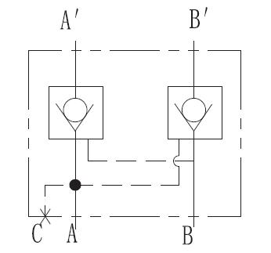
Double pilot operated check valve symbol

Slide 28
double pilot operated check valve

Slide 29
4. Double pilot operated check valve
When the directional valve is activated; flow is directed to one side of the valve thereby pushing the ball check there. This action causes the pilot pressure to open the poppet on the opposite side of the valve hence allowing the flow to return to tank.
In order to achieve perfect lock; the valve`s two ports (A and B) should not be under pressure. Therefore; the two ends are commonly connected to tank through a directional control valve that has a float centre position.

Slide 30
Double check with float centred dcv

Slide 31
Functions of a double piloted check valve
The double piloted check valve is used in hydraulic circuits for various purposes including:
* Preventing loads from dropping faster than pump supply
* Locking hydraulic cylinders when DCV is in neutral position
* Relieving excess pressure due to load or thermal expansion
* Helps in preventing cavitation.

